Slide 1




NEXT GEN EMPLOYABILITY PROGRAM
Creating a future-ready workforce
Team Members
College Name
Student Name : Ismath Fathima Rizwana S
Student ID : au960221104061
Arunachala College Of Engineering For Women

Slide 2

CAPSTONE PROJECT SHOWCASE
Project Title
Car Rentals Application with Django Framework
Abstract | Problem Statement | Project Overview | Proposed Solution | Technology Used | Modelling & Results | Conclusion

Slide 3
Abstract
The "Car Rental Application" is a sophisticated web-based platform developed using Python Django framework for the backend and a combination of HTML, CSS, JavaScript, and Bootstrap for the frontend. This application revolutionizes the car rental experience by offering users a seamless interface to browse, filter, and search for available vehicles, coupled with real-time inventory updates. With secure user authentication mechanisms in place, the application ensures data privacy and user accountability. Admin functionalities empower rental agencies to efficiently manage inventory, oversee bookings, and monitor financial transactions. By leveraging modern web technologies, this project aims to enhance user convenience and operational efficiency in the car rental industry.
Source :

Slide 4
Problem Statement
The traditional process of renting cars often involves cumbersome paperwork, limited availability information, and inefficient communication channels between rental agencies and customers. This lack of a centralized platform results in inconvenience for users and operational challenges for rental agencies. Moreover, the absence of real-time inventory updates and search functionalities makes it difficult for customers to find suitable vehicles quickly. Additionally, the absence of secure user authentication mechanisms poses a risk to data privacy and security
Source :

Slide 5
Project Overview
The "Car Rental Application" is a comprehensive solution designed to streamline the car rental process, utilizing Python Django framework for the backend and frontend technologies including HTML, CSS, JavaScript, and Bootstrap. The application provides users with a user-friendly interface to browse, filter, and search for available vehicles, with real-time inventory updates ensuring accuracy. Secure user authentication mechanisms enhance data privacy and accountability. Admin functionalities enable rental agencies to manage inventory, bookings, and financial transactions efficiently. By centralizing the rental process and leveraging modern web technologies, this project aims to revolutionize the car rental industry, providing convenience for users and operational efficiency for rental agencies alike.
Source :

Slide 6
Proposed Solution
.
The proposed solution involves the development of a comprehensive car rental application utilizing the Django framework, along with HTML, CSS, Python, Bootstrap, and JavaScript.
The application will feature a range of templates including dashboard, login, register, car details, search, cars, account, about, home, and services, ensuring a seamless and intuitive user experience.
The booking process will be streamlined with real-time availability updates and dynamic search capabilities, while responsive design using Bootstrap will ensure compatibility across various devices.
Secure authentication mechanisms will safeguard user accounts and personal information, ensuring peace of mind for customers.
On the administrative side, a centralized dashboard will empower administrators to manage car listings, user accounts, and bookings efficiently.
Source :

Slide 7


Technology Used
Front-end
Back-end
Source :

Slide 8
Modelling & Results
Modeling:
In the modeling phase, we meticulously structured the database using Django ORM, emphasizing entities such as cars, users, and reservations. Through entity-relationship diagrams (ERDs) and Django's migration system, we ensured a cohesive database schema, maintaining consistency across environments. This robust foundation provides scalability and flexibility for future enhancements and integrations, ensuring the application's adaptability to evolving requirements and user needs.
Results:
Our user interface delivers a seamless experience, enabling users to effortlessly browse, filter, and reserve cars. Real-time inventory updates keep users informed about availability and pricing. Robust authentication mechanisms ensure data privacy, while the intuitive admin dashboard empowers rental agencies. Comprehensive testing, successful deployment, and ongoing maintenance solidify our application's reliability and efficiency.
Source :

Slide 9
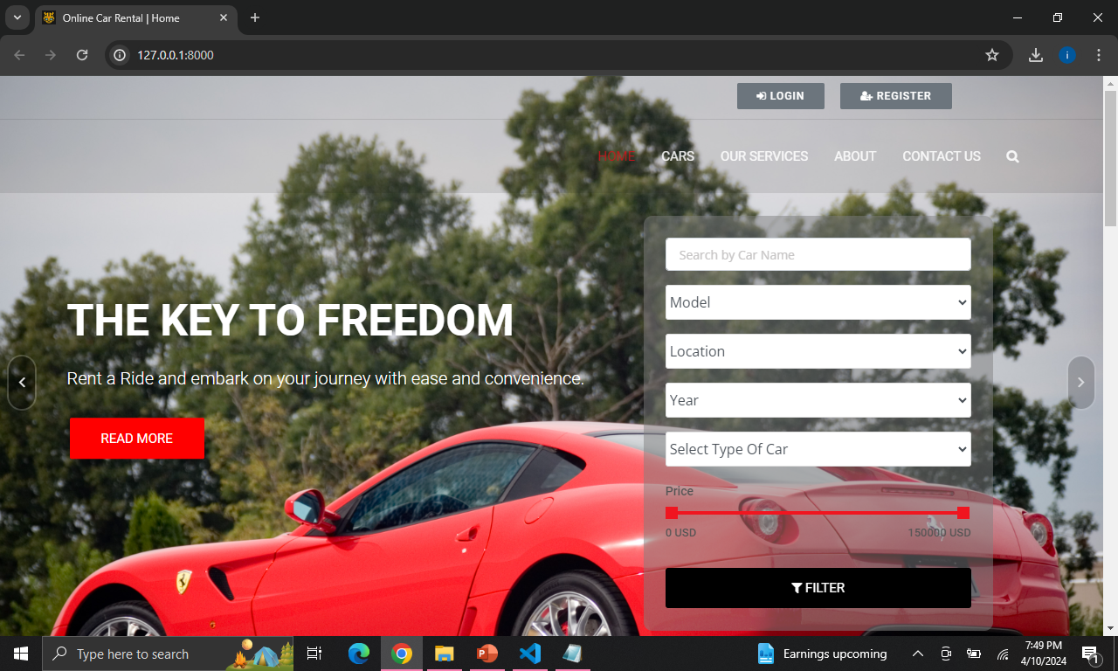
Homepage

Slide 10
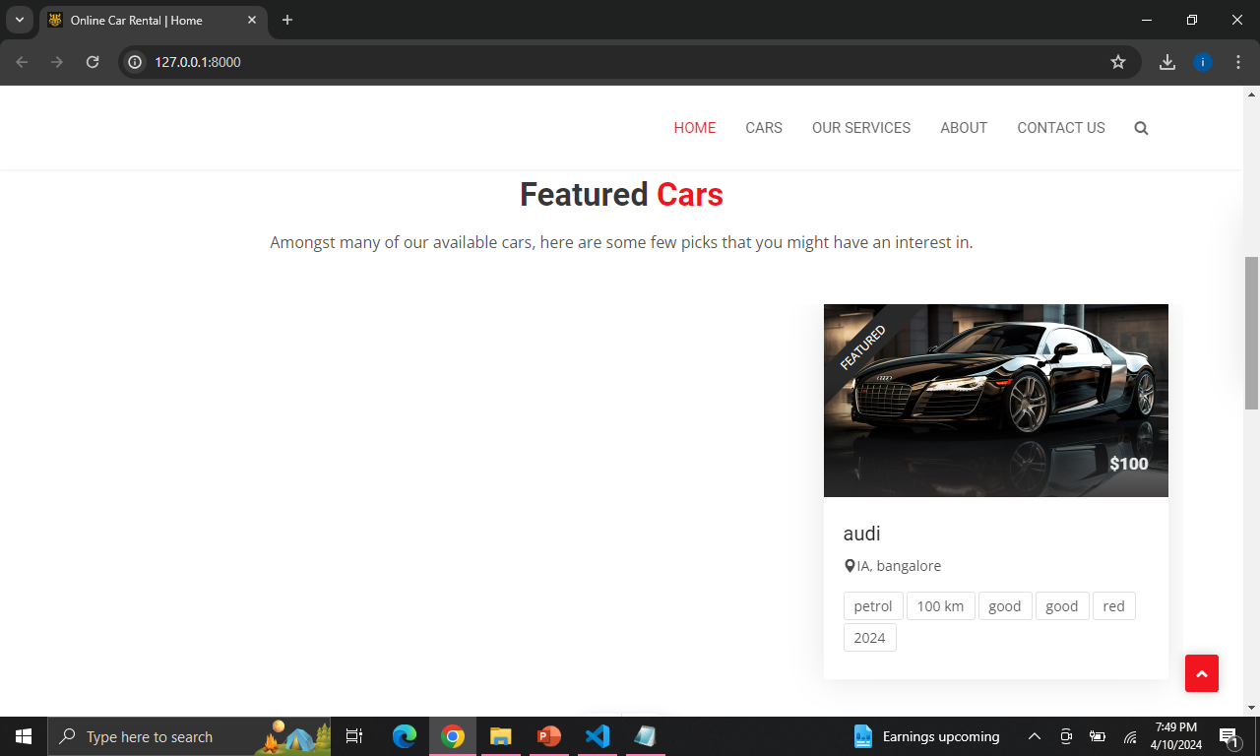
Homepage

Slide 11
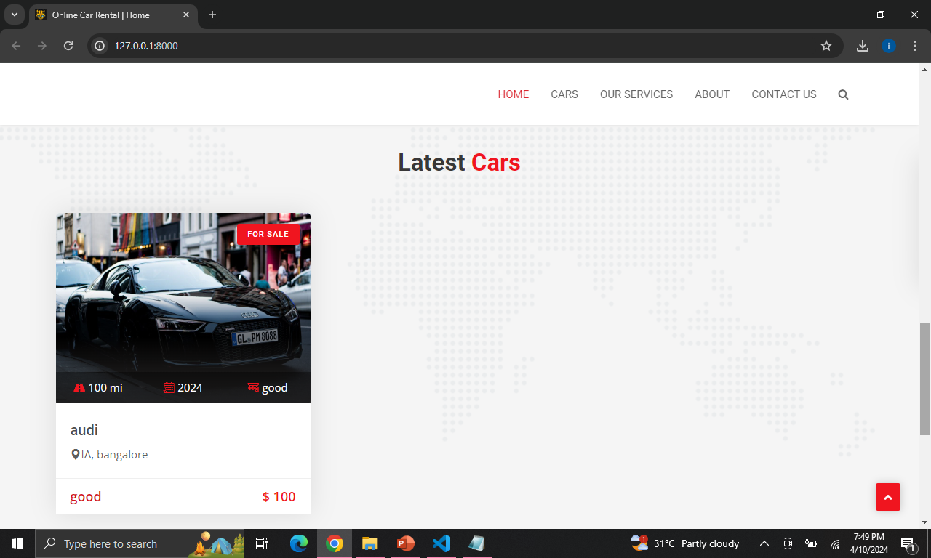
Homepage

Slide 12
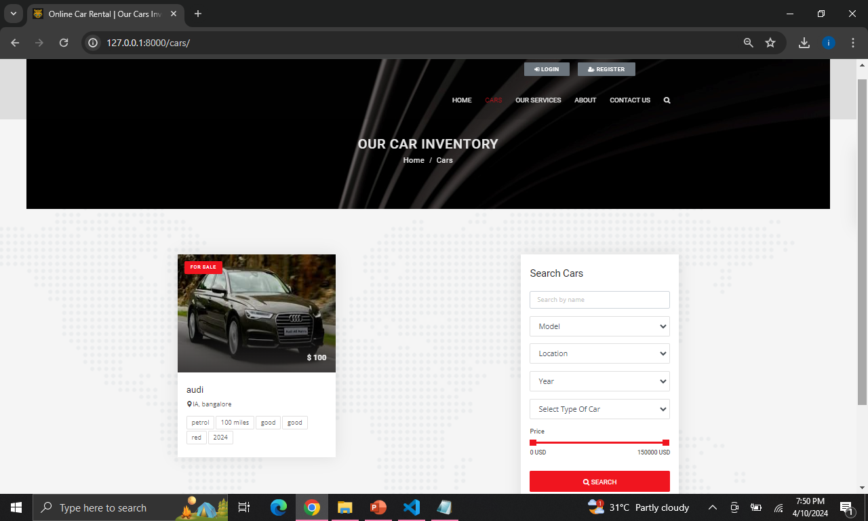
Cars-Page

Slide 13
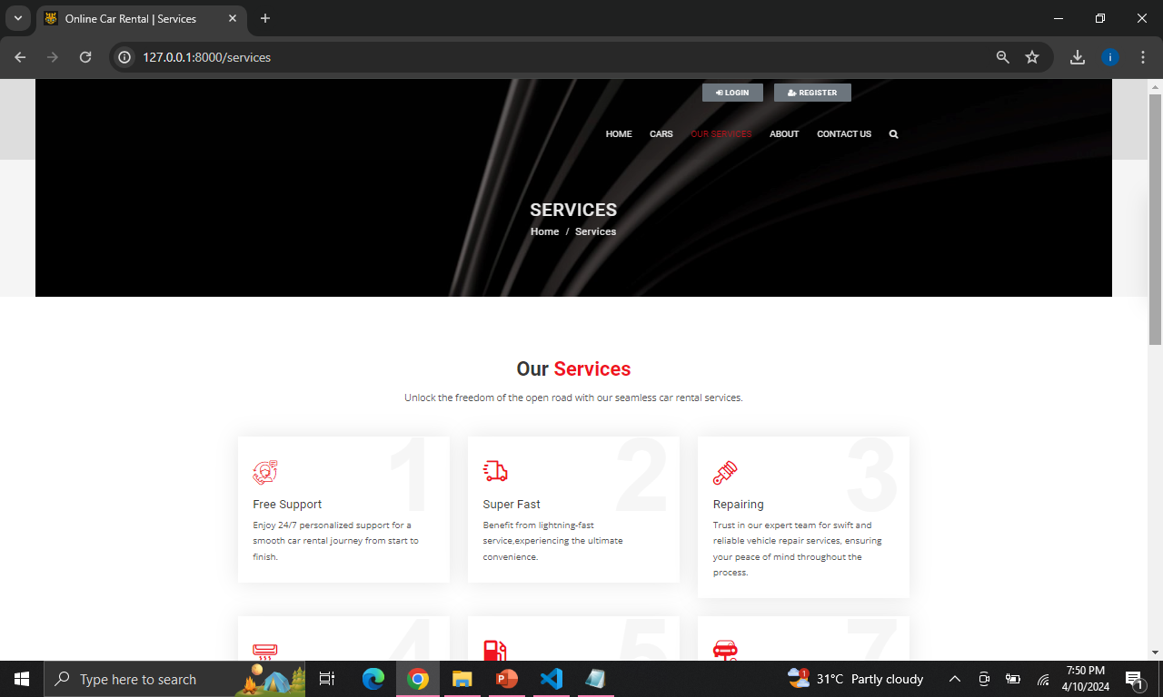
Service-Page

Slide 14
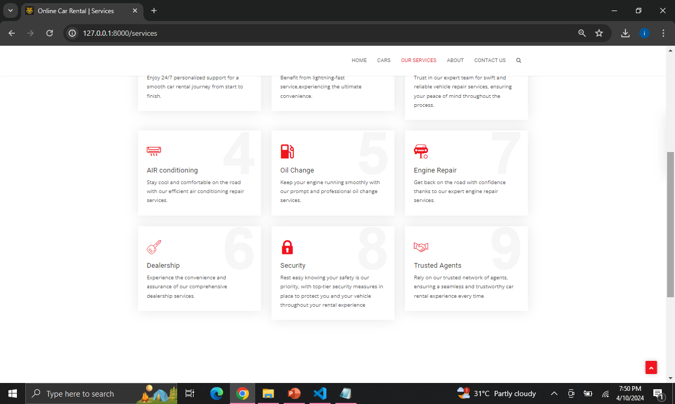
Service-Page

Slide 15
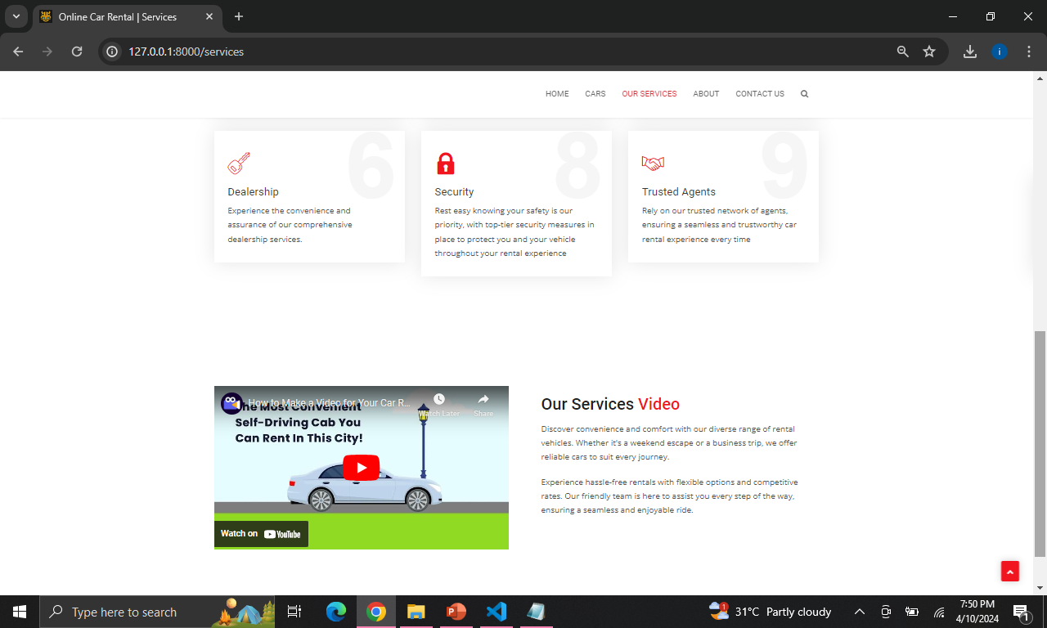
Service-Page

Slide 16
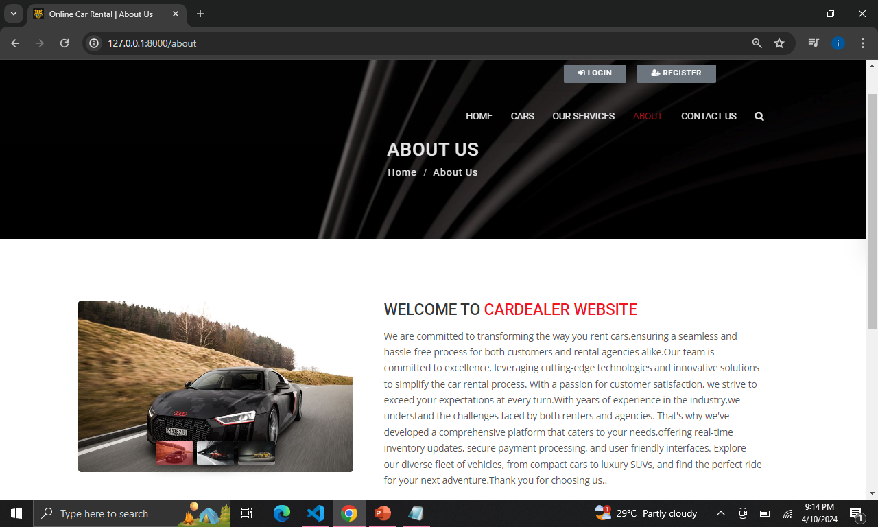
About Us-Page

Slide 17
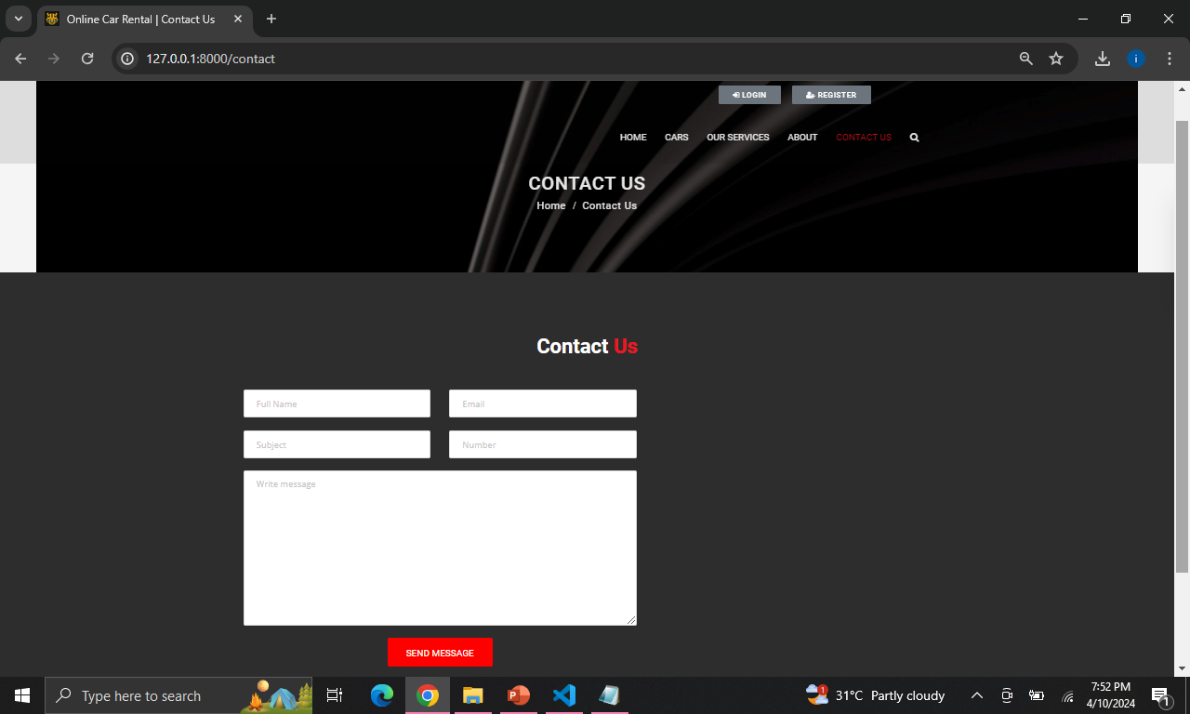
Contact Us-Page

Slide 18
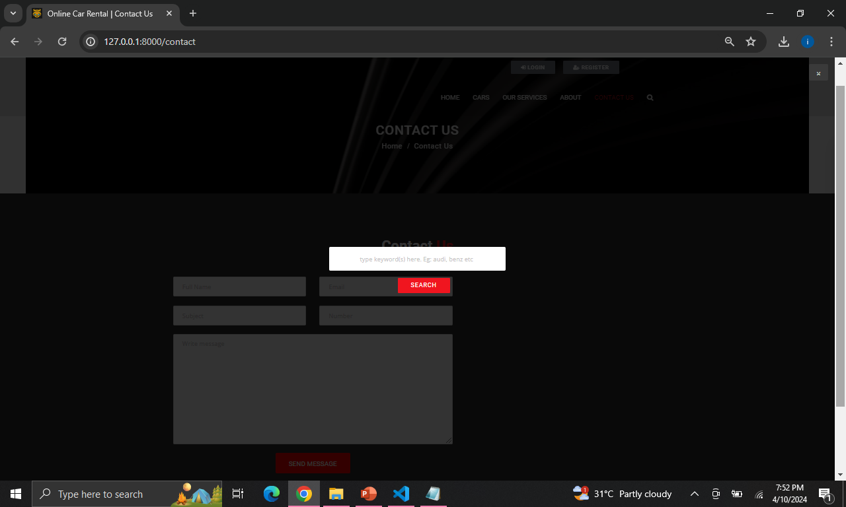
Search-Page

Slide 19
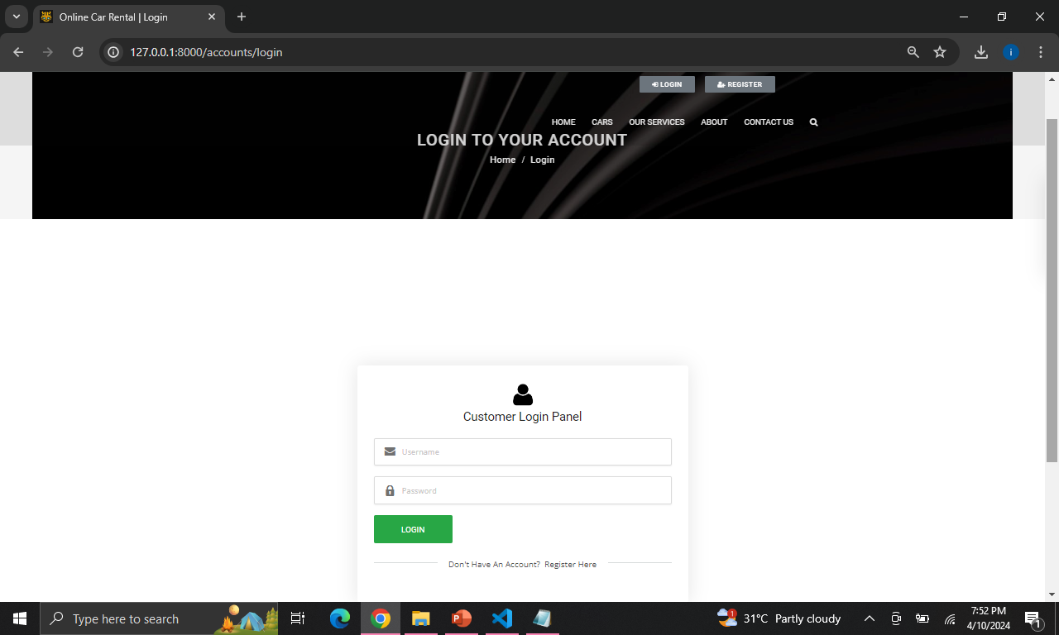
login-Page

Slide 20
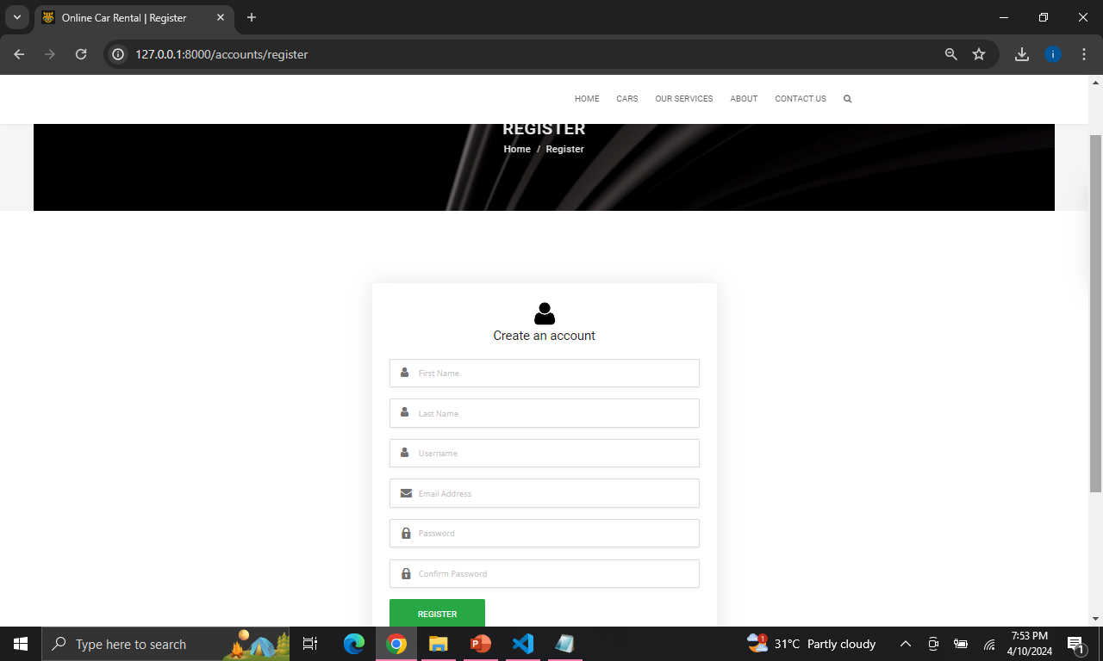
Register-Page

Slide 21
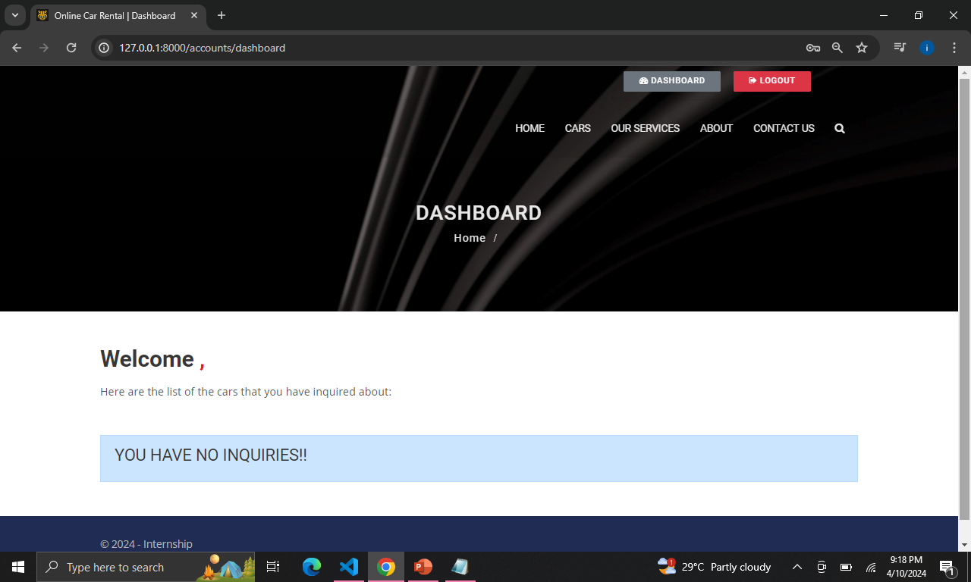
Dashboard-Page

Slide 22
Future Enhancements:
Implement a feature allowing users to rate and review their rental experiences, providing valuable feedback to both other users and administrators.
Enhance the search functionality by adding advanced filters such as car features, specifications, and user preferences to help users find their desired vehicles more efficiently.
Introduce a notification system to alert users about upcoming reservations, important updates, or special promotions, enhancing communication and user engagement.
Integrate a secure payment gateway to support various payment methods like Gpay, PhonePe, Net Banking, offering users convenience and flexibility during the booking and payment process.
Expand the application's services by incorporating additional features such as car maintenance scheduling, roadside assistance booking, or even partnerships with local businesses for additional amenities or services.

Slide 23
Conclusion
The "Car Rental Application" successfully addresses the challenges of the car rental industry by providing a user-friendly platform for seamless browsing, reservation, and management. With its robust backend powered by Django and intuitive frontend interface, the application enhances user experience while ensuring data security and integrity. The project's adaptability and scalability lay a strong foundation for future enhancements and integrations. Overall, the implementation of comprehensive testing, successful deployment, and ongoing maintenance reaffirms the application's reliability and efficiency, making it a valuable asset for both users and rental agencies in the ever-evolving landscape of car rental services.
Source :

Slide 24
Thank You!
Notes:
Thank You !!

